Slide 1
Machine Learning Overview
Data To Decision Workflows

Slide 2
Motivation for a Data-to-Decision Workflow
Goal is to make better decisions
Many ways to make decisions
Heuristic-based Human Judgement
Human-built computational models (e.g. expert systems)
Data Analysis (correlation, trends)
Statistical Machine Learning suggests learning from Data
But where does the data come from?
And what resulting decision activities will the data support?

Slide 3
Where does ML fit in a workflow?
A workflow is a defined sequence of steps used to process something / do something / answer a question
ML is often in the middle of the workflow. For example, ML can help:
Determine what objects an image contains
Decide which category an observation in the data belongs to
Predict a value of a variable based on other observed values
Before ML can occur, data* is gathered, wrangled, cleaned…
After ML gives an output, decisions are made
*Data can be numbers, text, audio, images, video….

Slide 4
Workflow Motivation
Since decisions derived from Data are only as good as the data, we must ensure the data collection, management, and analysis process is sound
CRISP-DM
KDD

Slide 5
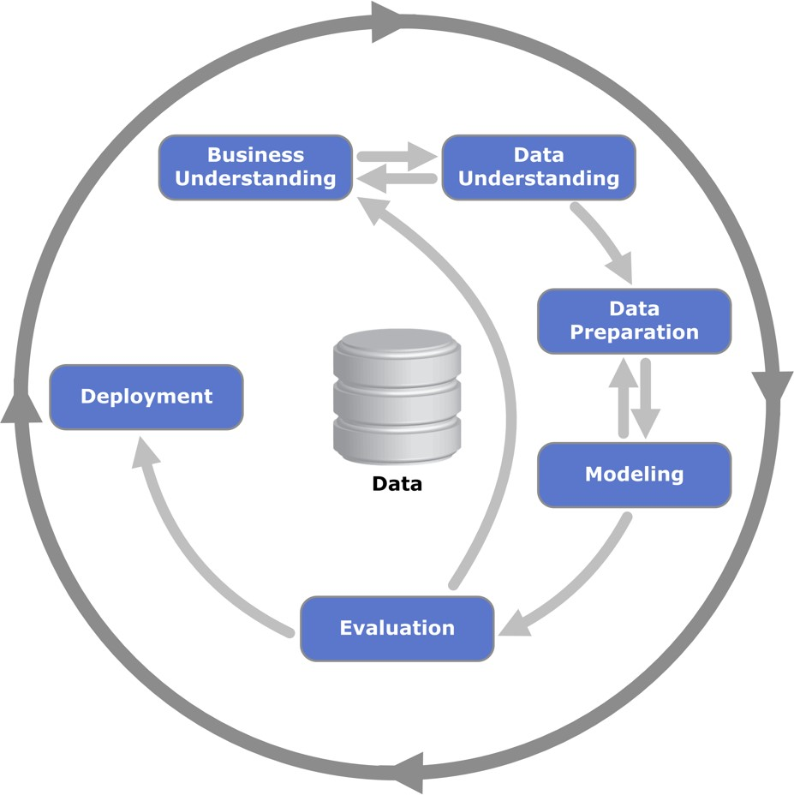
Cross Industry Standard Process for Data Mining (CRISP-DM)
Business understanding | Data understanding | Data Prep | Modeling | Evaluation | Deployment
Determine business objectives | Collect initial data | Select data | Select modeling techniques | Evaluate results | Plan deployment
Assess situation | Describe data | Clean data | Generate test design | Review Process | Plan monitoring & maintenance
Determine DM objectives | Explore data | Construct data | Build model | Determine next steps | Produce final report
Produce project plan | Verify data quality | Integrate data | Assess model |  | Review project
 |  | Format data
Process diagram showing the relationship between the different phases of CRISP-DM
https://en.wikipedia.org/wiki/Cross_Industry_Standard_Process_for_Data_Mining#/media/File:CRISP-DM_Process_Diagram.png
CC-SA Kenneth Jansen
Ó. Marbán et al., “A Data Mining & Knowledge Discovery Process Model,” in Data Mining and Knowledge Discovery in Real Life Applications, no. February, J. Ponce and A. Karahoca, Eds. Vienna, Austria: I-Tech, 2009, pp. 483–453.

Slide 6
CRISP-DM: Business Understanding
Understand project objectives and requirements
Develop a data mining definition and plan
Business understanding | Data understanding | Data Prep | Modeling | Evaluation | Deployment
Determine business objectives | Collect initial data | Select data | Select modeling techniques | Evaluate results | Plan deployment
Assess situation | Describe data | Clean data | Generate test design | Review Process | Plan monitoring & maintenance
Determine DM objectives | Explore data | Construct data | Build model | Determine next steps | Produce final report
Produce project plan | Verify data quality | Integrate data | Assess model |  | Review project
 |  | Format data

Slide 7
CRISP-DM: Data Understanding
Collect Data
Document / Describe data
Become familiar / Explore data
Identify data quality problems
Determine data subsets
Form investigative hypotheses
Business understanding | Data understanding | Data Prep | Modeling | Evaluation | Deployment
Determine business objectives | Collect initial data | Select data | Select modeling techniques | Evaluate results | Plan deployment
Assess situation | Describe data | Clean data | Generate test design | Review Process | Plan monitoring & maintenance
Determine DM objectives | Explore data | Construct data | Build model | Determine next steps | Produce final report
Produce project plan | Verify data quality | Integrate data | Assess model |  | Review project
 |  | Format data

Slide 8
CRISP-DM: Data Preparation
Construct final dataset from initial raw data
Select / Subset / Combine / Join data
Clean data (remove bad data / outliers?)
Construct missing data (impute)
Format data
Business understanding | Data understanding | Data Prep | Modeling | Evaluation | Deployment
Determine business objectives | Collect initial data | Select data | Select modeling techniques | Evaluate results | Plan deployment
Assess situation | Describe data | Clean data | Generate test design | Review Process | Plan monitoring & maintenance
Determine DM objectives | Explore data | Construct data | Build model | Determine next steps | Produce final report
Produce project plan | Verify data quality | Integrate data | Assess model |  | Review project
 |  | Format data

Slide 9
CRISP-DM: Modeling
Select modeling techniques
Create the test/eval/assess design
Build model
Fit & tune/calibrate model parameters
Assess models
Business understanding | Data understanding | Data Prep | Modeling | Evaluation | Deployment
Determine business objectives | Collect initial data | Select data | Select modeling techniques | Evaluate results | Plan deployment
Assess situation | Describe data | Clean data | Generate test design | Review Process | Plan monitoring & maintenance
Determine DM objectives | Explore data | Construct data | Build model | Determine next steps | Produce final report
Produce project plan | Verify data quality | Integrate data | Assess model |  | Review project
 |  | Format data

Slide 10
CRISP-DM: Evaluation
Evaluate quality using performance criteria on unseen data
Evaluate model’s ability to answer business objectives
Example – model might require more data than we can collect
Determine how to use the output of the model to make decisions
Business understanding | Data understanding | Data Prep | Modeling | Evaluation | Deployment
Determine business objectives | Collect initial data | Select data | Select modeling techniques | Evaluate results | Plan deployment
Assess situation | Describe data | Clean data | Generate test design | Review Process | Plan monitoring & maintenance
Determine DM objectives | Explore data | Construct data | Build model | Determine next steps | Produce final report
Produce project plan | Verify data quality | Integrate data | Assess model |  | Review project
 |  | Format data

Slide 11
CRISP-DM: Deployment
Integrate the model into the decision-making process
Continuous Assessment: ensure model works well over time
Maintenance: when to update/fix/retune the model
Business understanding | Data understanding | Data Prep | Modeling | Evaluation | Deployment
Determine business objectives | Collect initial data | Select data | Select modeling techniques | Evaluate results | Plan deployment
Assess situation | Describe data | Clean data | Generate test design | Review Process | Plan monitoring & maintenance
Determine DM objectives | Explore data | Construct data | Build model | Determine next steps | Produce final report
Produce project plan | Verify data quality | Integrate data | Assess model |  | Review project
 |  | Format data

Slide 12

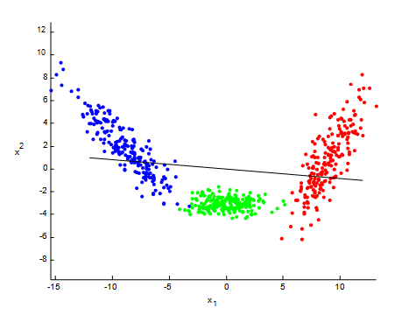

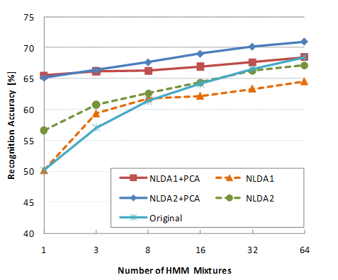

Knowledge Discovery in Databases
Extract Knowledge
Structure Discovery & Performance Analysis
Preprocessing & Transformation
Selection

Slide 13
KDD: Selection
Determine the question which needs to be answered
Scientific / Hypothesis Driven
Choose the data which supports the question
Selection

Slide 14
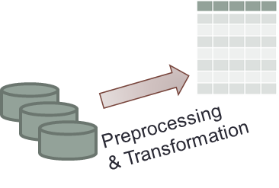
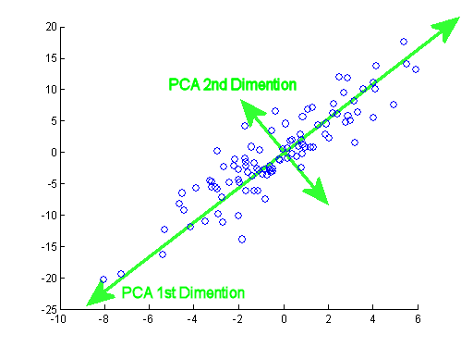
KDD: Preprocessing and Transformation (Data Wrangling)
Preprocessing:
Selected Data may be in many forms
Raw text / Image / Video / Markup Language / Time-Series Signal
Extract desired Features from data
Dimensionality reduction / filtering
Event counts, measurements, pixel values
Generate observations (rows) with feature values (columns)
Impute missing or incorrect values?
Transformation:
Scale the feature values
Project observations into a different space/subspace

Slide 15
KDD: Structure Discovery and Performance Analysis
Structure Discovery (Model Fitting)
Data Exploration – find trends
Regression – estimate a value
Classification – determine membership
Clustering – determine groupings
Inference – determine important features
Cross-Validation – tune the model
Performance Analysis
Assess quality of model on unseen data
Structure Discovery & Performance Analysis

Slide 16
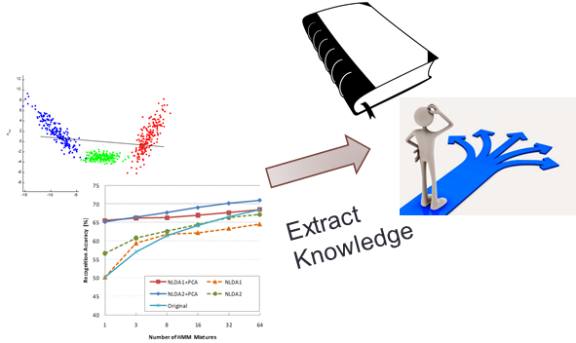
KDD: Extract Knowledge
The ultimate goal of machine learning
Knowledge:
Generate understanding of the relationships within the data
Understand how features affect the output
Decision-making
Using knowledge to determine actions

Slide 17
KDD: Challenges and Cautions
Data mining vs. Data dredging
Missing data
Massive datasets / High dimensionality
Overfitting & Statistical significance
Concept drift / Nonstationary data

Slide 18
Backup Slides

Slide 19
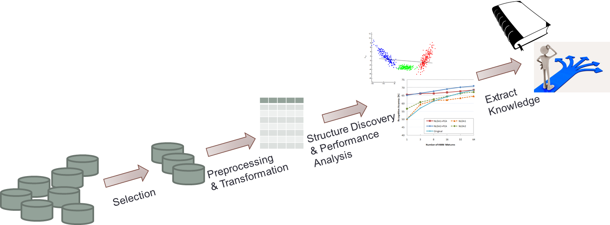
Audience Participation – Minute Paper #1
Choose one of the following companies and describe how the company might use the KDD process to make a business decision. Describe details of the steps
NETFLIX
Amazon
Blizzard (computer gaming)
USAA Insurance
Delta Airlines

Slide 20
Audience Participation – Minute Paper #2
How do you envision using the KDD process in your AFIT research?
Outline what needs to occur in each step
What portion of the research could you work on for your class project?

